Slide 1
Meeting with Oksana
27/03

Slide 2
Tasks From Last Meeting
Do uncertainty propagation for the final product and define goals
Also getting to know the actual state of this uncertainty
Try regression to get grasp of the accuracy trade off.
Work on the implementation of a dataset with trajectories instead of images
Start generating trajectories with IsaacSim
Simulator constraint field of view

Slide 3
Announcements

Slide 4
Good News! I had a bug
I was dividing the image values by 255 twice.
Convergence is achieved in around half as many epochs now

Slide 5
Completed Tasks

Slide 6
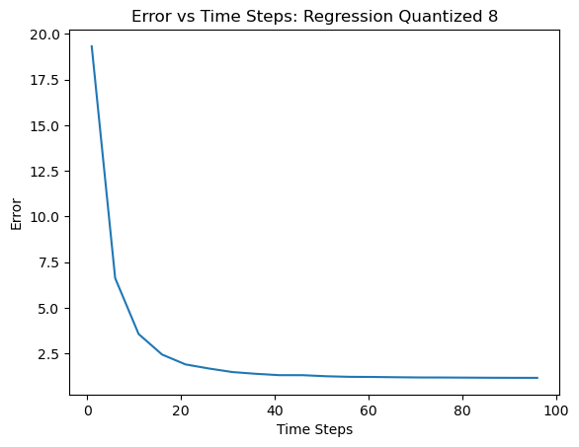
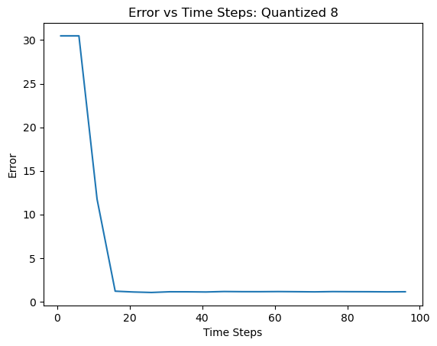
Trained Regression Model

Slide 7
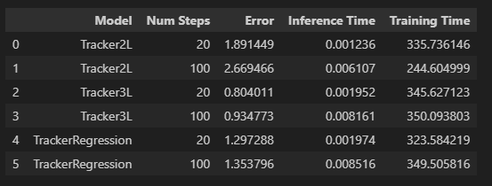
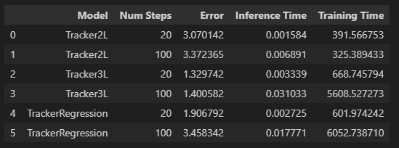
Model Comparison
Quant 8
Quant 4

Slide 8
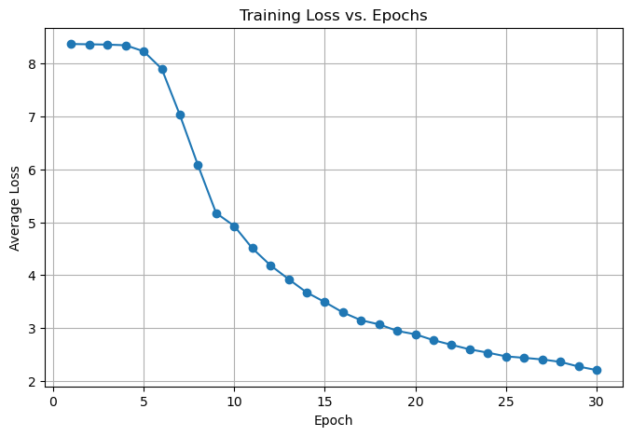
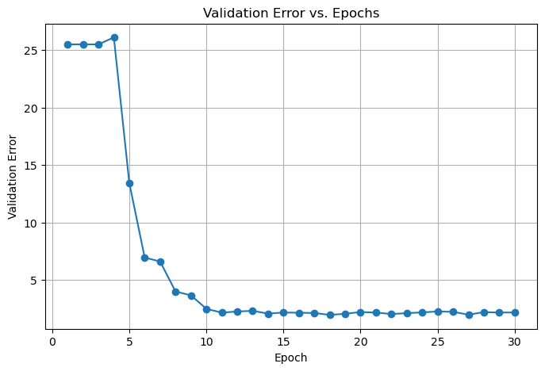
Created Dataset for Videos
Accepts variable length sequences
Dynamic batch size
Trained one model with the sequences and converged
The data contained wrongly labeled images though. Suboptimal

Slide 9
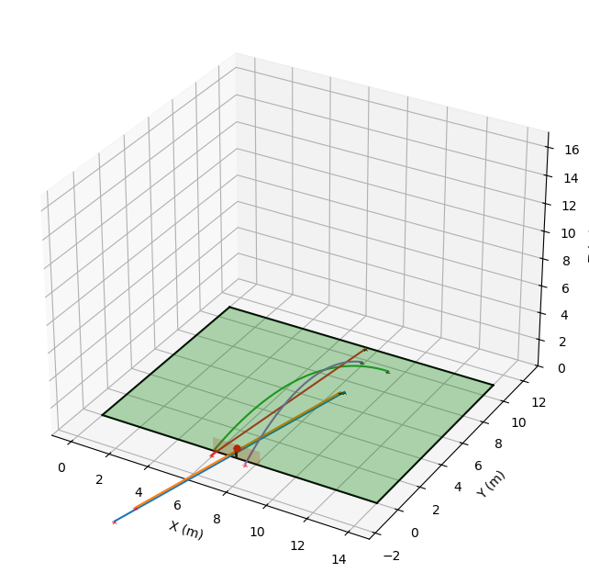
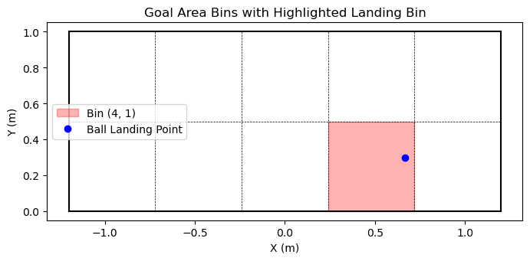
Simulator
Added constraint so the ball needs to start within the field of view
Added bin calculation to the trajectory generation

Slide 10
Ongoing and Proposed Future Tasks

Slide 11
Ongoing Tasks
Generating a dataset with IsaacSIM
Trouble setting everything up
Finally I can run python scripts in there

Slide 12
Future Tasks
Get Delta_x distribution for the error propagation

